Slide 1

ITSM Dashboard
Bhasker Kumar

Slide 2

Agenda
WHY ITSM Dashboard (SCQA)
WHAT is ITSM Dashboard
HOW to implement ITSM Dashboard
Quick Demo

Slide 3


Introduction
This is my question to most of the leadership of ICT department. If in the morning you have a choice to go to a dentist or go to a budget meeting with your other colleagues, what would you choose? I know it will be a dentist
Offering a versatile solution package for constructing a dynamic costing model for ITSM dashboards, particularly geared towards optimizing ICT FinOps
With ability to absorb, curate and augment information on more than 50 attributes across 15 dimensions. Designed to do hierarchical consolidation of information with ability to meaningfully slice and dice information​
Gain trust with business value first, collaborative, deterministic and transparent ICT FinOps journey

Slide 4

WHY

Slide 5
WHY- Situation & Challenges
Limited visibility and granular insights into IT spending hinder real-time monitoring, prioritization, and control.
Challenges arise in aligning IT service investments with business objectives and assessing proportional value creation/maintenance compared to ICT service TCO.
The inability to present a granular breakdown of ICT recharged costs breeds distrust between regional and Group processes, in charging ICP services to regions or non-corporate entities.
Defending budget requests in annual board meetings is difficult due to the absence of granular budget lines and a unified ICT source for stakeholders.
ITSM FinOps involves numerous stakeholders, complicating matters as key stakeholders often lie outside the IT organization. The ICT organization must be more prudent in fund allocation, given its cost centre status.
The lack of harmonized reporting/analysis definitions/KPIs, exhaustive dimensional scope, and limited FinOps staff necessitate increased automation and process harmonization.

Slide 6
WHY- Questions & Answers
How to get data granularity | Define correct Members for dimensions, Service line, Asset category, ICT organization rollup and other dimensions and attributes
How to get transparent and collaborative ICT FinOps, Process . (Fosters synergy between IT and other business functions) | Create application which have users from other departments like Finance & legal, HR etc. Should have ability to extend controlled role-based access to multiple users across organization
How to get all data prep done with limited FinOps capacity in ICT organization (Automation) | Incorporate data integration to wide list of applications, data allocation algorithms, define processes to spread data accountability to cost centre and system owners
How to extend ICT budget efficacy | Define KPIs & Measures, Alerts for decision makers , Use data analytics and ML to predict trend & anomalies Augment data by industry standards and benchmark e.g. Cloud FinOps
How to make an affordable, adoptable and scalable system | Give robust excel interface, keep the design flexible to handle new attributes and dimensions. Keep /user cost of run and build cost of project low.

Slide 7

WHAT

Slide 8
ITSM Dashboard Description
A ITSM dashboard is a centralized control panel displaying crucial metrics and data essential for daily oversight. Key areas covered typically include below:
ICT Financial costing
IT Operations: Monitoring the status and performance of IT systems and infrastructure.
Projects and Business Initiatives: Tracking progress on digital business initiatives and IT-related projects.
Additional Responsibilities: Incorporating metrics on expanding areas like cybersecurity, data compliance, and customer-facing technology.
Given the evolving nature of the CIO role, dashboard metrics must be tailored to individual job duties and organizational needs. To complement the decision-making capacity of the CIO by bringing
Efficiency: Streamlines workflows, saving time by consolidating key indicators into one accessible platform.
Insight: Provides a clear snapshot of IT performance, facilitating quick analysis and decision-making.
Real-time Data: Offers up-to-the-minute insights into business processes, essential for tracking IT operations and driving organizational performance.

Slide 9
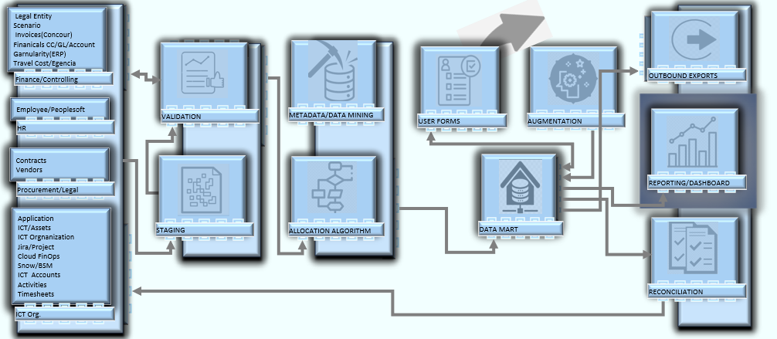
Data Flow

Slide 10
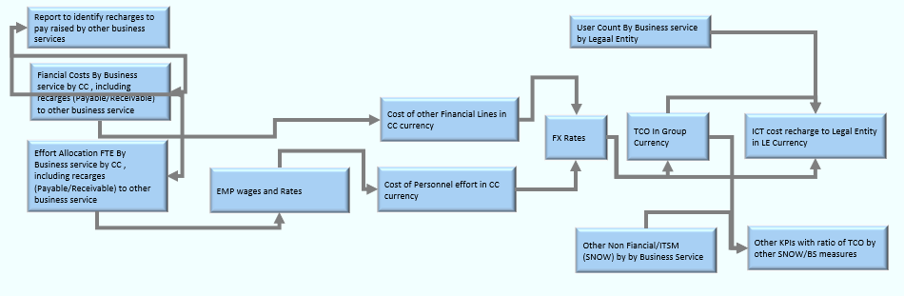
Key Measures and Calc. Flow

Slide 11
Attributes
Application
ICT Accounts
Activities
Assets
Cost centre
Contracts
Employee
ICT Organization
ICTOrganization23
Legal Entity
Scenario
Vendor
Year
BY App Non-Financials
EMP Wages & Rate
Financial Data
Labour Allocation
User By App/Entity
FX Rates
ERP/SAP FICO
Invoicing/ Concur
HRMS/People soft
Travel Cost/Egencia
ITSM non-fin/SNOW
Project/Jira
Timesheet/Jira
EPM/Hyperion
Technology onboarding
Procurement
Legal/Contracts
CIO (Chief Information Officer)
ICT controller (Group)
ICT controller (Regional)
Executive ICT Leadership Team
IT Managers and Directors(ICT CC owners)
Finance Managers and Analysts
Business Unit Managers
Compliance and Risk Managers
IT HR partner
Dimensions
Forms
Inbound Systems
User Profiles

Slide 12
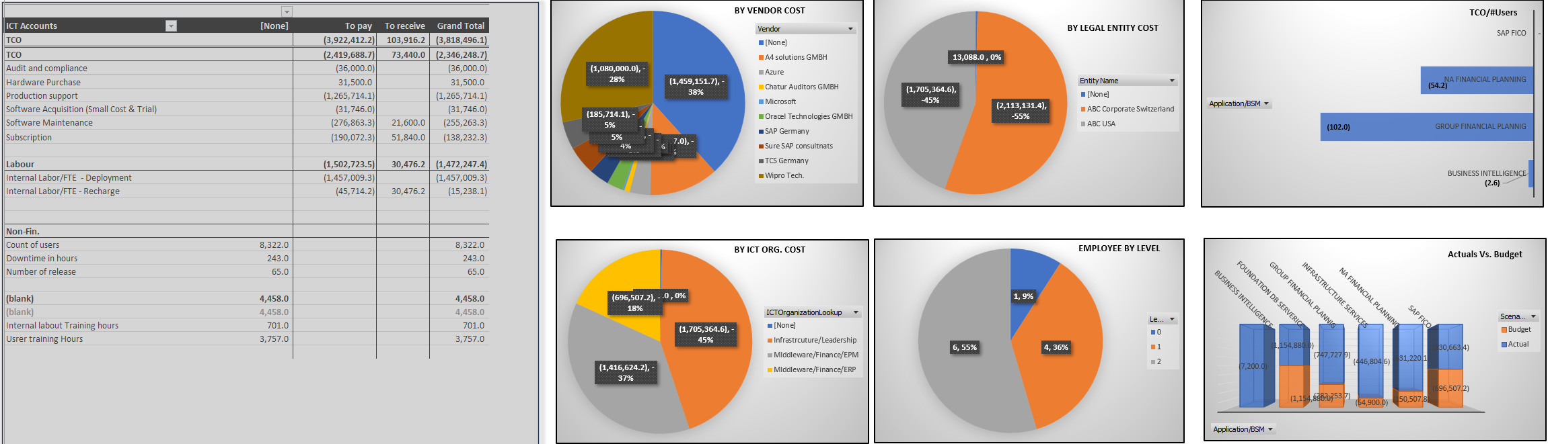
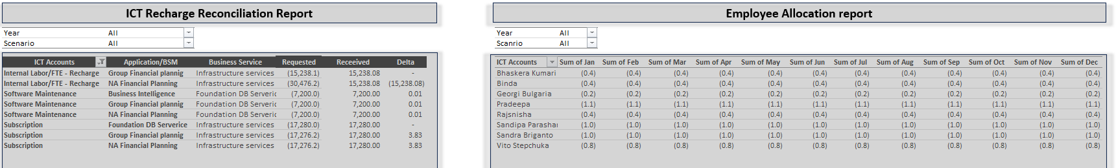
Glimpse of Reports

Slide 13

"Secure your footing before forging ahead. One step at a time".
Bhasker Kumar & ChatGPT

Slide 14

HOW

Slide 15
Solution Delivery Key Milestones
Get actual data extracts from all source systems and use AI to identify Meta data, data and reference data to populate the Excel Cost Model.
Provide the tool to key stakeholders to identify columns, validations, and allocation rules.
Finalize the Excel model with agreed attributes and business rules.
Build backend tables and automate source data with allocation rules.
Connect the Excel tool using Pivot Query and Power Automate CSV upload.
Start putting a USER App on top of the data model.
Pending UAT and any UI-related changes.
Assign security roles and other elements around it. Go live with the USER App solution
Use actuals data to prepopulate budget data.
1
2
3
4
5
5
7
8
9

Slide 16
Common Pitfalls
CC Owner or Application owner is Accountable for the TCO
Lack of CC structure in finance systems , to reflect ICT org structure
Intertangling of , CC , ICT org , Business service definition, Apps and Asset categories
There can be a tendency to recharge all the cost from corporate to entities
There can be a tendency to book most amounts under unclassified bucket “[None]”, even if categories have been defined
Group CIO and Regional CIOs alignment needs to be stronger than Regional CIO and Regional CFO
Business initiative costs are hidden under ICT regional cost
97% BI projects, which are not pushed top to bottom, end up not being adopted

Slide 17

DEMO

Slide 18
Case – BI Service
In this role, I will impersonate a manager overseeing the ICT BI service. Currently, my responsibilities include managing and expanding a data asset exceeding 15TB, handling over 20 million transactions daily. I oversee a diverse portfolio encompassing 20+ tech portfolio, with a dedicated team comprising 6 internal members and 12 external collaborators spanning across 4 countries.
Allow me to introduce myself, Tony Kumar. As part of today's demonstration, I will undertake the following tasks:
- Update the necessary tech stack within our tech inventory.
- Ensure that the BI service clears recharges, received as incurred costs from Infra & DB services.
- Facilitate the timely payment to our vendors.
- Allocate personnel efforts effectively across ICT service applications.
- Calculate the Total Cost of Ownership (TCO) for our applications.
- Calculate and sign off ICT recharge to various regions and countries, for the BI service.
- Review non-financial data to assess our Key Performance Indicators (KPIs).

Slide 19


Q&A
Bhasker kumar
Contact_bhasker@yahoo.com
Linkedin

